Slide 1
Enhancement Due to Photonic Coupling in Nanocavity Structures
Bumbia, Amal;
Abudayyeh, Hamza;
Liu, Zhida;
Li, Xiaoqin
Department of Physics UT Austin

Slide 2
Background

Slide 3
How do quantum emitters work?
Optical properties!
Spontaneous photon emission!
2-level Quantum emitter
Electromagnetic environment
How can we alter this environment to favorably influence the decay rate of the system?
Multiple 2-level systems with differing polarization or wavelength
Notes:
Quantum emitters possess optical properties that are a result of an interplay between the energy levels of the emitter and its electromagnetic environment. Given a 2-level system, you can modify its decay rate by altering the environment.
Quenching occurs when the emitter is too close to the metal so no photons within < 4 nm from the metal surface are emitted. Thus, there is no optical coupling. This is a loss mechanism.

Slide 4
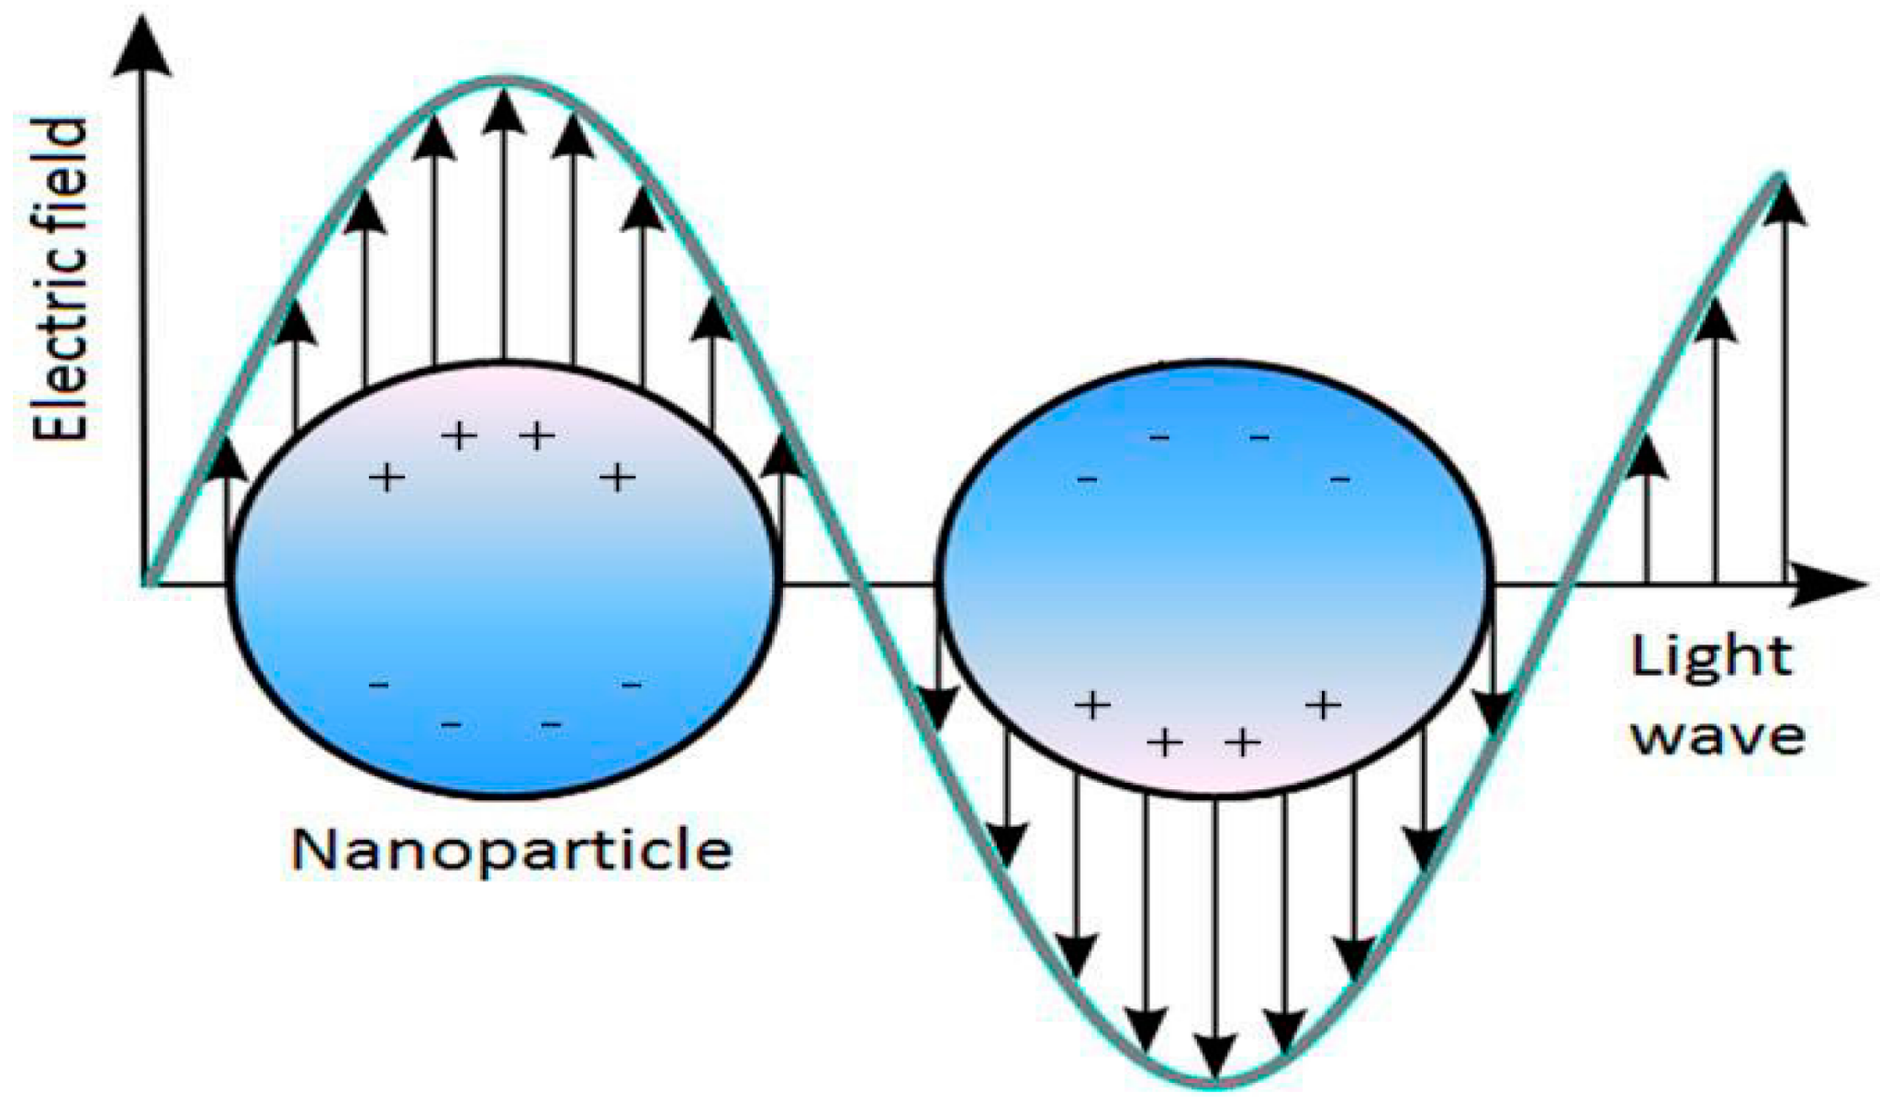
Why can a nanoscale quantum emitter can have emitting behavior?
e-
Notes:
interaction between the excitons of the emitter and the plasmons of the nanoparticles

Slide 5
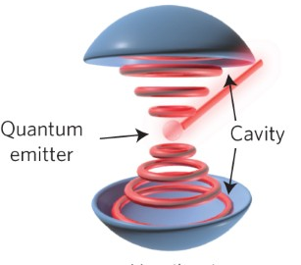
What is the interplay between quantum emitters and cavities?
enhanced photon emissions into free space
coupled resonantly
exchange photons
contains plasmonic resonances
emits into the plasmonic cavity
focuses the emission fields into a mode volume
Notes:
A plasmon refers to a partially optical and partially electronic excitation. Plasmonic cavity has different modes; looks different than this

Slide 6
Cavities can impact emitters in a few ways:
decay rate enhancement --- The weak coupling of a 2-level emitter to a cavity leads to the modification of the spontaneous emission rate. The emitter can have multiple radiative modes and some nonradiative processes
emission redirection --- the intrinsic radiation pattern of a quantum emitter is omnidirectional, making it hard to collect emitted photons. Cavities can redirect the emission to the desired optical mode with an efficiency $\eta _{NA}$. Different modes can have different efficiencies.
absorption enhancement --- cavities alter the absorption cross-section of the emitter which causes absorption enhancement and lowers the saturation power needed from the pump laser.

Slide 7
Coupling parameters:
emitter's decay in free space $\Gamma _0$\\
cavity's loss rate $\kappa$\\
emitter-cavity coupling coefficient $g$\\
This is dependent on the overlap of the photonic cavity and the resonances of the 2-level system.
Due to the interplay between the photonic cavity and the system, we are able to enhance some processes at the expense of others.
For instance, if the resonances of the plasmonic cavity are vertical, they selectively enhance dipole emitters with a vertical dipole.
Not only are we increasing the lifetime, but we are also altering our characterization and probability of the emission.
Notes:
What matters is coherence and its impact on the photonic field. We aim to enhance all photons in the emission.
A process will impact a lower-probability event more than one with a higher probability since quantum efficiency has a lesser chance of being improved in the latter.

Slide 8
Weak Coupling Regime
We are concerned with the weak coupling regime $g < \kappa$, $\Gamma _0$.
Here, the photon is released by an excited emitter due to spontaneous emission and lost to far-field radiation modes leaving the cavity in a vacuum state.
In this case, the cavity becomes the system's environment and results in a modified decay rate $\Gamma = F \Gamma _0$ where $F = \frac{3}{4\pi ^2} Q \frac{\lambda ^3}{V}$ (Purcell factor - represents the shortening of lifetimes; losses ensure that it is not directly related to the number of emitted photons), $Q \approx \frac{1}{\kappa}$ (cavity quality factor), and the cavity mode volume $\frac{V}{\lambda ^3}$.
The advantage of the weak coupling regime is that for emitted photons, the probability that they will be reabsorbed by the emitter is low compared to the likelihood of the photon escaping the cavity.

Slide 9
What are the effects of weak coupling between plasmonic nanocavities and excitons?

Slide 10
How does plasmon-exciton coupling effect emission enhancement?

Slide 11
Background
Sample 1 : Gold Nanocube

Slide 12
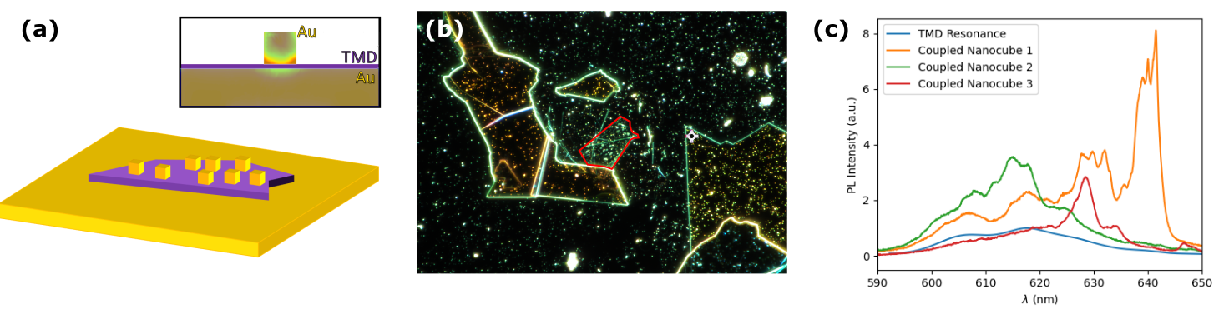
Sample 1: Gold Nanocube : Optical Data
Material: Monolayer TMD
Film-Cube Separation: 8-9 nm
The lightning-rod effect causes the corners of the cubes to be the regions of greatest enhancement
cavity
nanocubes
(70-100 nm)
TMD
gold foil
Notes:
Simulation of single nanoresonance of one cube and colors are intensity of the field, increase of intensity in the corners of cube, lightning rod effect — one reason why nanocubes work how they do
A reason why nanocubes enable photonic enhancement is because the electromagnetic field is more intense at the corners of the cube - the lightning-rod effect. Nanocube size and film-cube separation impact where plasmonic resonances occur.
The excitons of the emitter and plasmons of the nanocubes couple in a plasmonic cavity which focuses the emission fields into a mode volume. The mode volume impacts the probability of the field interacting with the emitter. A higher probability in this regard increases the probability of spontaneous emission and decreases the lifetime. The photons emit from the cavity and into free space, enhanced due to the weak coupling mechanism.

Slide 13
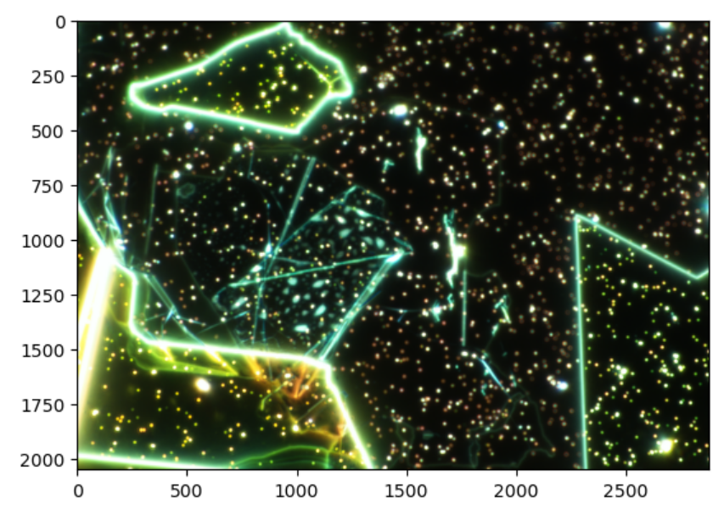
Darkfield Spectroscopy
white light scattering by nanocavities
measure plasmonic resonances
Notes:
Upon imaging the sample using dark field spectroscopy, we are able to focus on the white light
scattering by the nanocavities and thus measure plasmonic resonances.

Slide 14
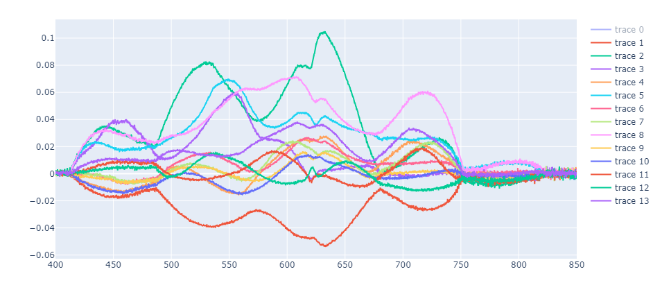
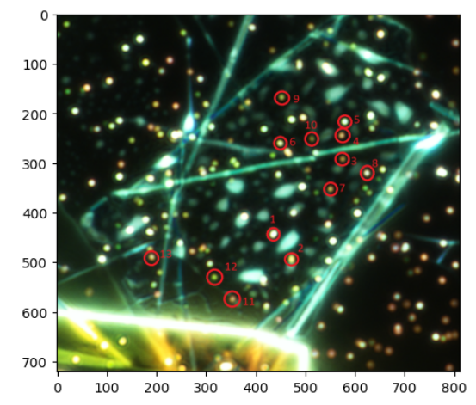
Labelled points on the darkfield image
Where do the plasmonic resonances occur?
This is a point where the data gets murky…
540 nm
625 nm !!!
725 nm

Slide 15
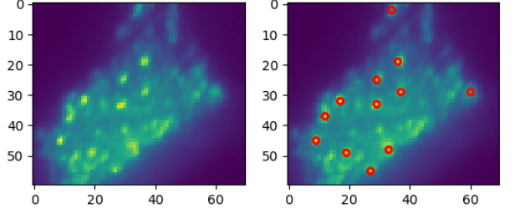
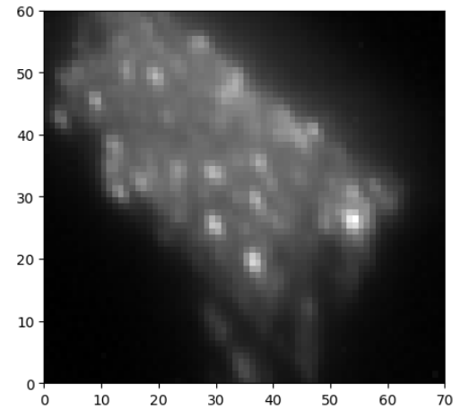
Hyperspectral Spatial Image
well localized points with nanocubes
intensity coming out of these points is enhanced

Slide 16
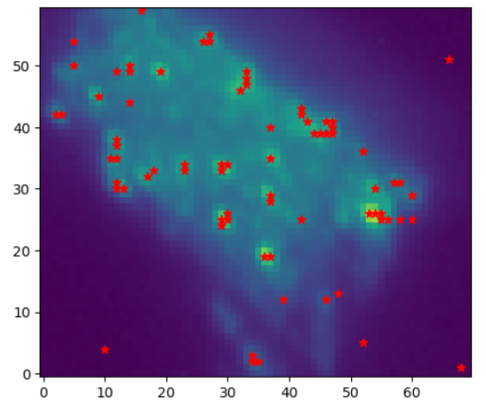
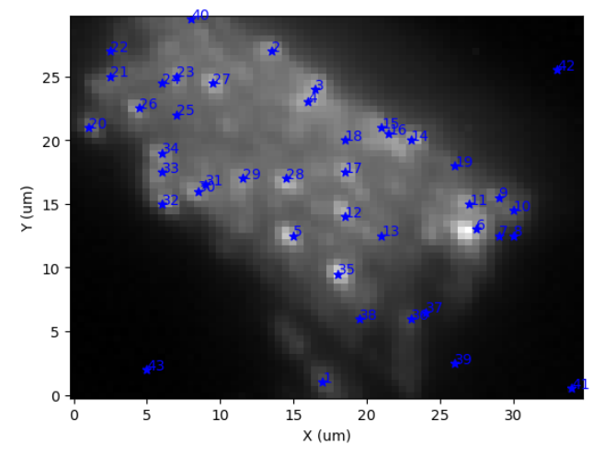
Notes:
Points of interest

Slide 17
Photoluminescence (PL)
excite sample at different wavelengths
measure exciton resonances
longer wavelengths enhanced
greater, non-uniform intensity enhancement along nanocubes
find overlap between the wavelengths where plasmonic resonances and enhancement occur
Enhanced exciton emissions!
Notes:
Overlap between the plasmonic resonances and exciton excitation
provides evidence for the coupling as it facilitates enhancement. Longer wavelengths are enhanced, and there is greater, non-uniform intensity enhancement along the nanocubes. Differently sized cubes enhance different parts of exciton spectrum. We see that the enhanced resonances have the same polarizations and spectral resonances as the plasmonic resonances.

Slide 18
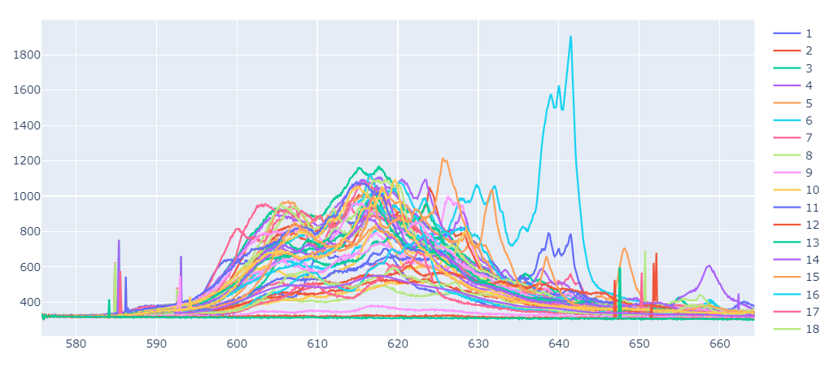

Slide 19
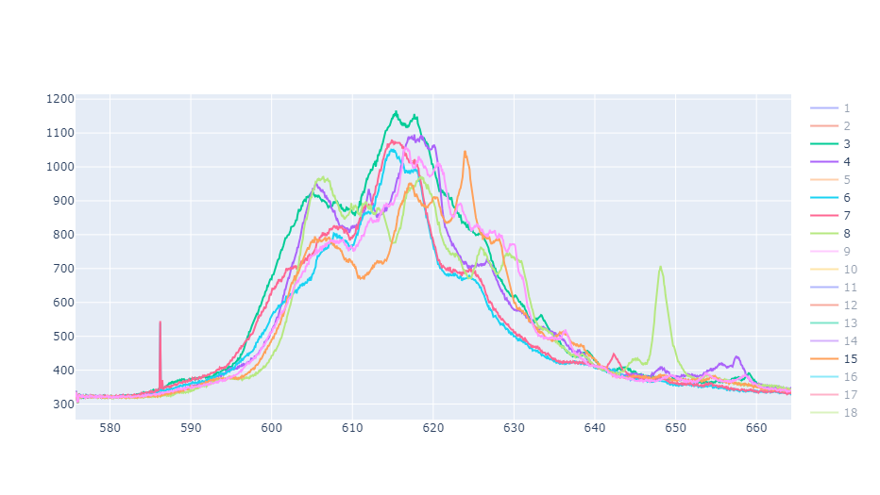
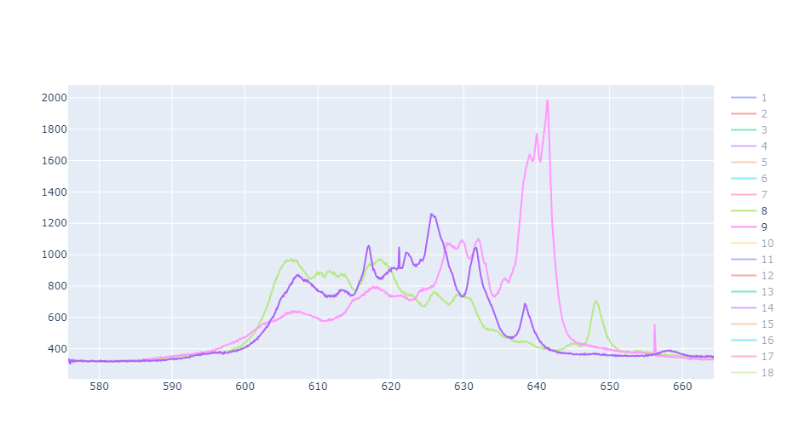
Notice the peaks between 603-609 nm and 612-620 nm and around 625 nm
Sight trough at 608-611 nm and again at 620-625 nm
These were the brightest spots - less uniformity between them but we still have peaks at around 605, 630 , 640 and 615 nm
Recall the plasmonic spectrum via darkfield spectroscopy and the peaks around 625 nm — possible overlap between plasmonic and exciton resonances?

Slide 20
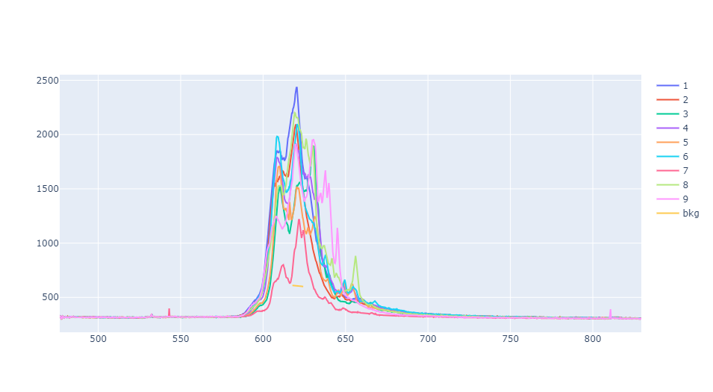
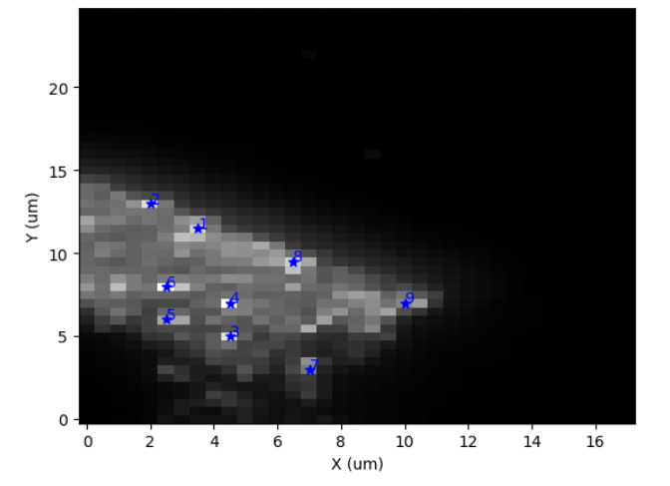
Room Temperature Higher Power PL
Peaks are largely concentrated at 610, 625, 640 nm

Slide 21
Background
Sample 1 : Gold Nanocube
Sample 1 : Silver Nanocube

Slide 22
Sample 1: Silver Nanocube : Optical Data
Material: Monolayer TMD
Film-Cube Separation: 8-9 nm
Initially, the silver nanocubes were placed onto the original gold nanocube sample. There was an issue with the trilayer sample so it needs to be remade.
cavity
nanocubes
(70-100 nm)
\ Ag
TMD
gold foil
Notes:
Simulation of single nanoresonance of one cube and colors are intensity of the field, increase of intensity in the corners of cube, lightning rod effect — one reason why nanocubes work how they do
A reason why nanocubes enable photonic enhancement is because the electromagnetic field is more intense at the corners of the cube - the lightning-rod effect. Nanocube size and film-cube separation impact where plasmonic resonances occur.
The excitons of the emitter and plasmons of the nanocubes couple in a plasmonic cavity which focuses the emission fields into a mode volume. The mode volume impacts the probability of the field interacting with the emitter. A higher probability in this regard increases the probability of spontaneous emission and decreases the lifetime. The photons emit from the cavity and into free space, enhanced due to the weak coupling mechanism.

Slide 23
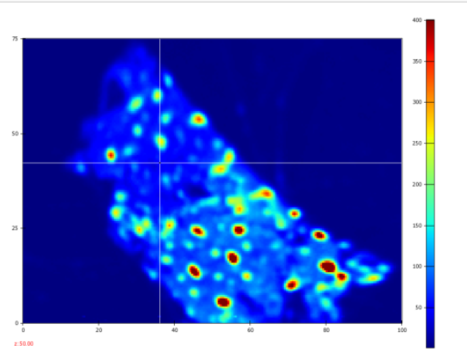
Photoluminescence (PL)
Focus on each point individually to obtain a spectrum over a range of wavelengths
This image is focused on a bare portion of the sample for control purposes

Slide 24
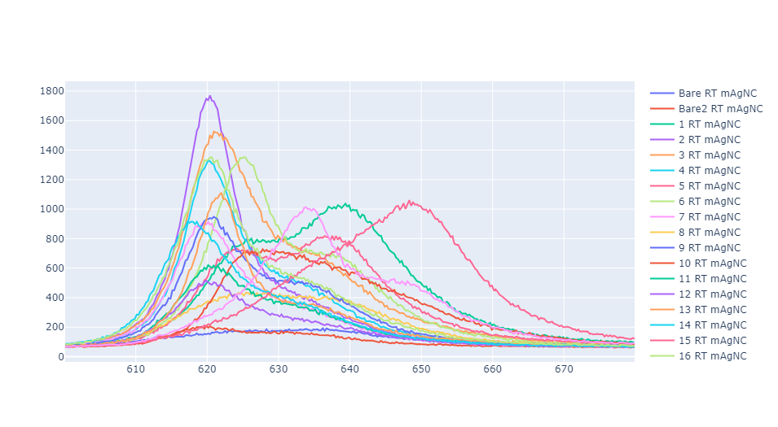

Slide 25
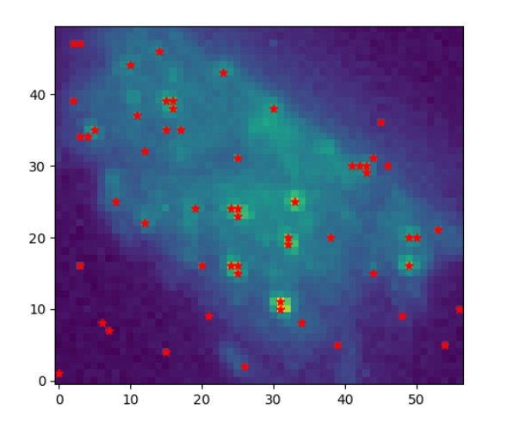
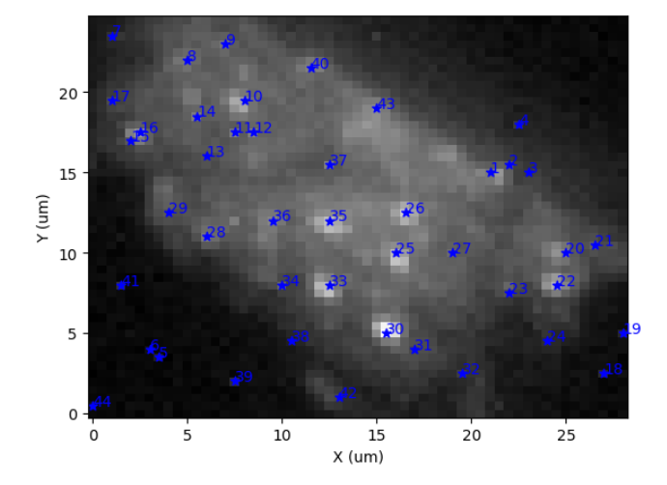
Hyperspectral Spatial Image - Cryogenic

Slide 26
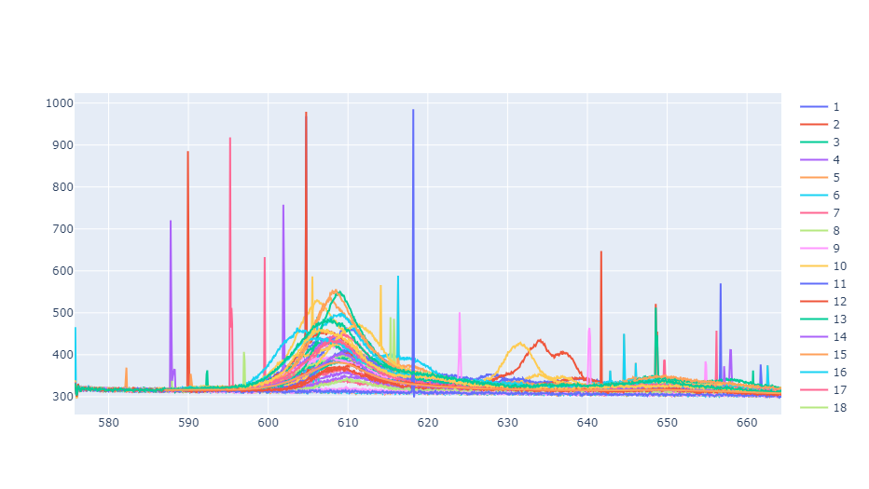

Slide 27
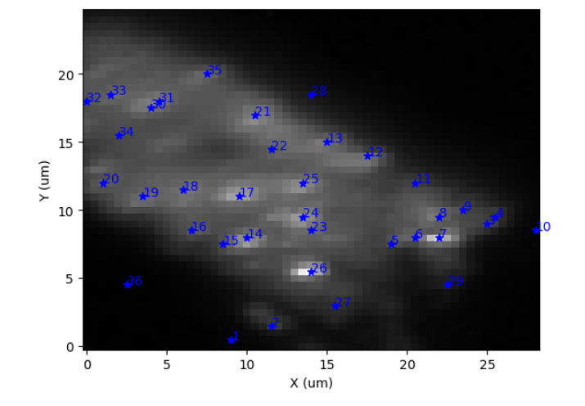
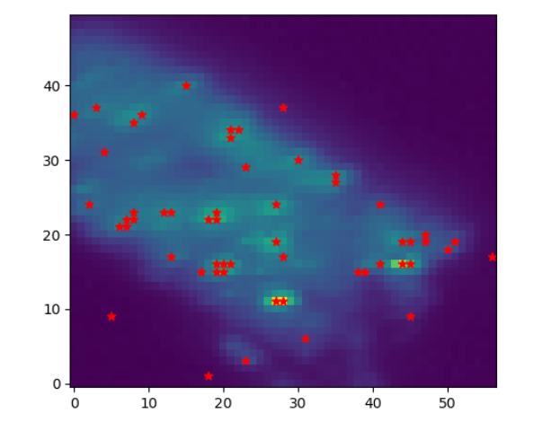
Hyperspectral Spatial Image - Cryogenic 20uW

Slide 28
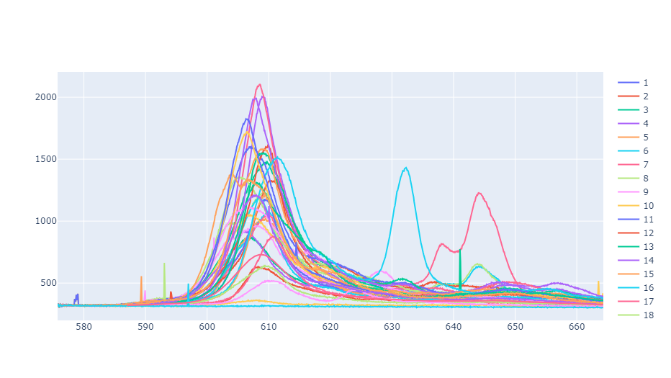
Notes:
The cryogenic measurement at a higher power allowed us to focus on that group of similar spectra in the 600-620 nm range also indicated in the initial cryogenic measurements

Slide 29
Do the spectra of the same points peak at the same wavelengths between the samples? How does the presence of silver nanocubes impact the measurements?
Can we identify which points are likely silver nanocubes?
In general, how do the peaks differ between the gold and silver nanocubes? Does either provide more obvious enhancement?
Comparing Results

Slide 30
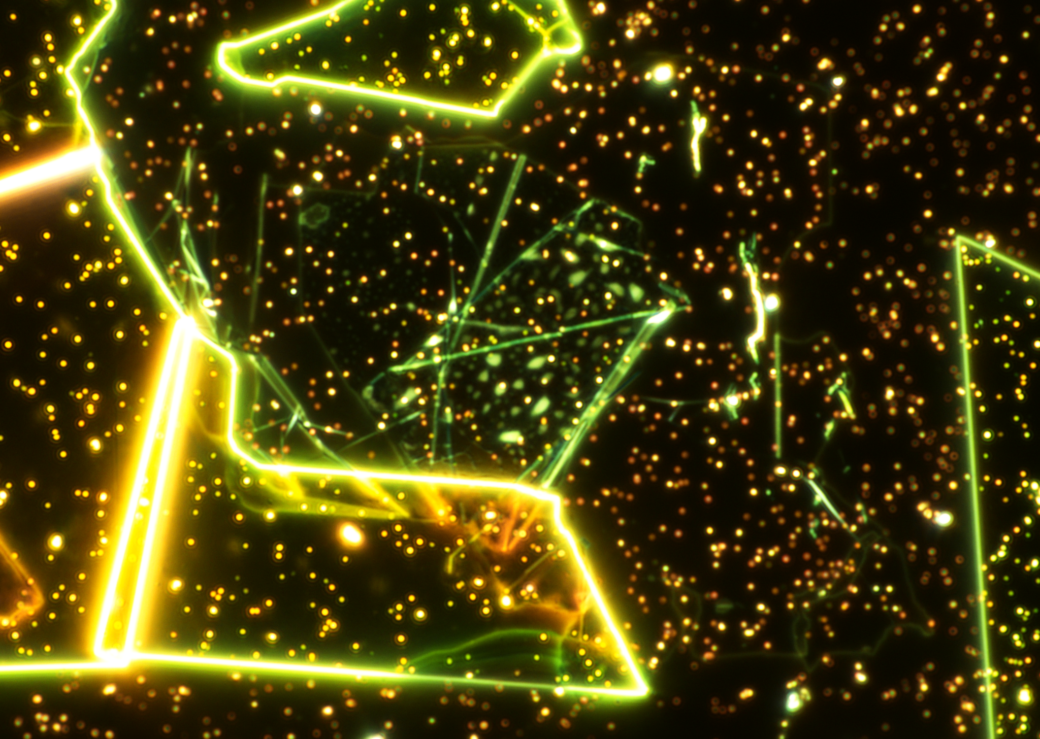
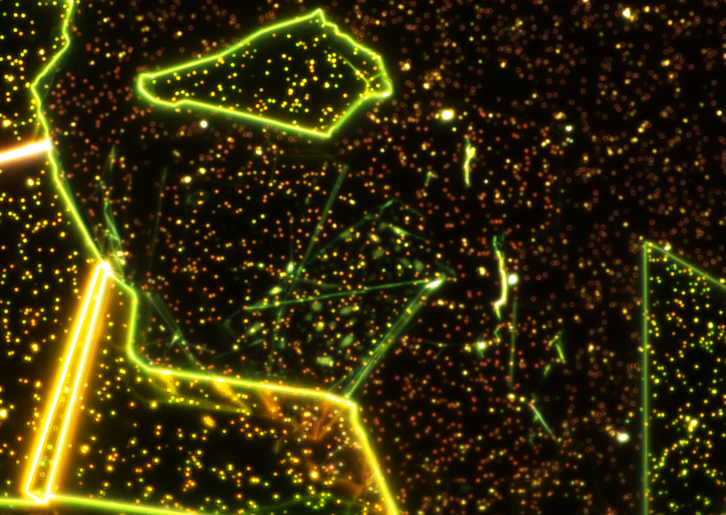
Sample 1 Before and After Silver Nanocube Placement

Slide 31
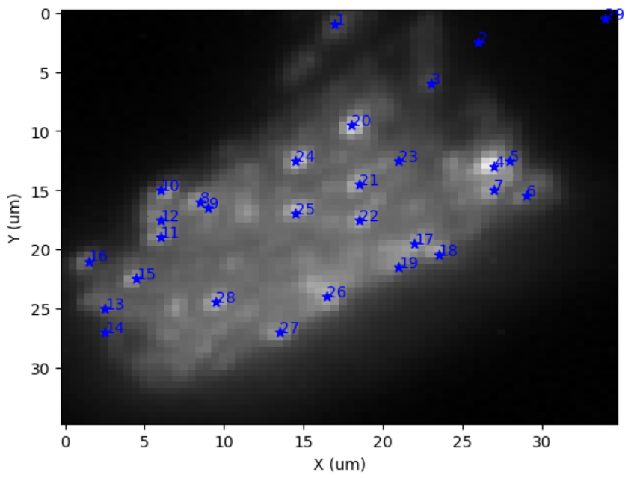
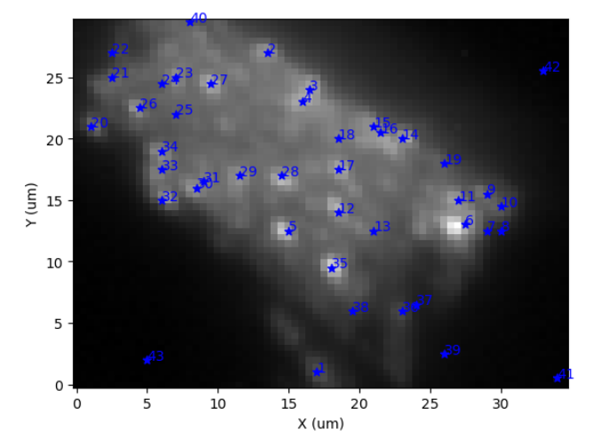
Room Temperature PL Gold v. Silver
It appears that the correlations between the new and old points are as follows:
1 - 35
4 - 11
5 - 5
6 - 12
8 - 28
10 - 14
11 - 30
12 - 29
15 - 26
So we will compare the plots. Notice how the spectra will look very different but still preserve the location of certain peaks.

Slide 32
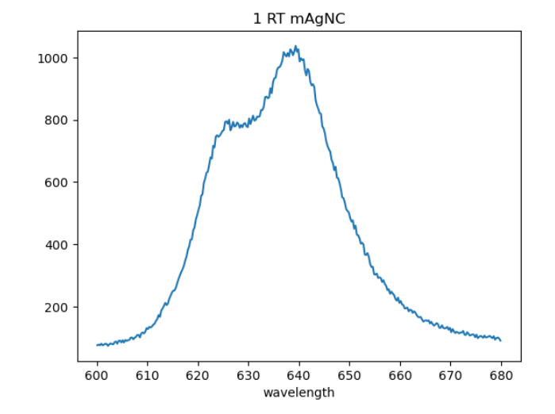
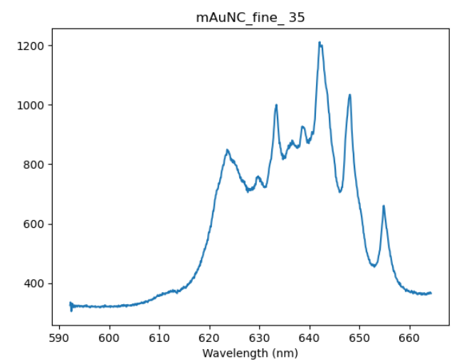

Slide 33
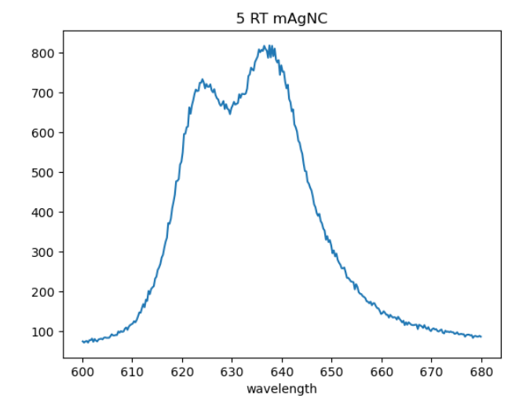
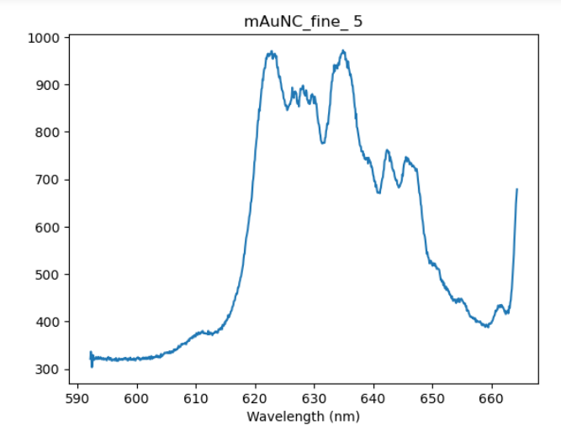

Slide 34
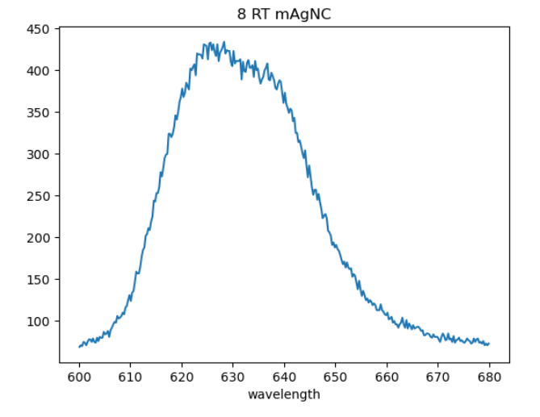
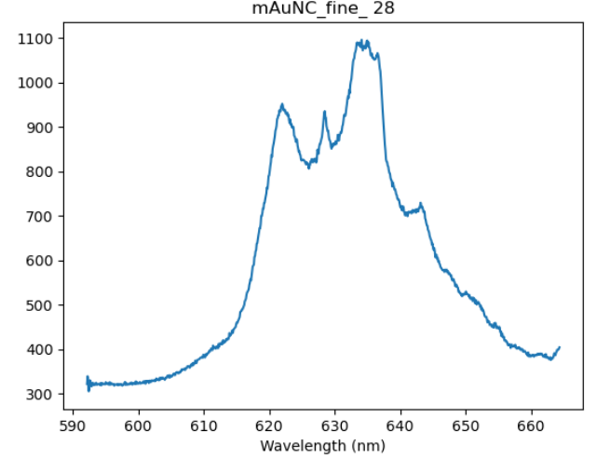

Slide 35
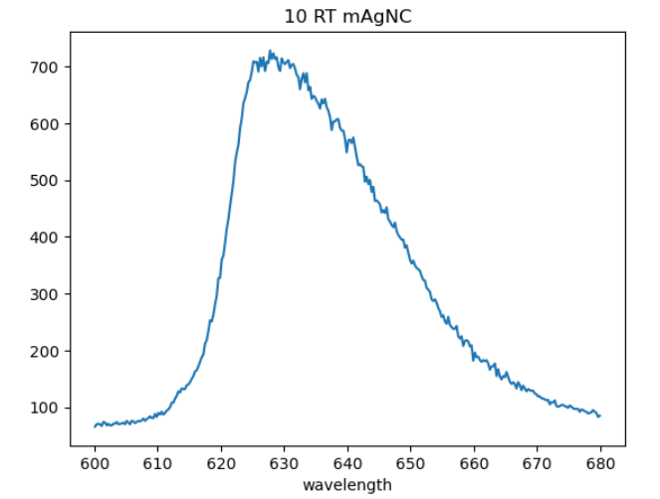
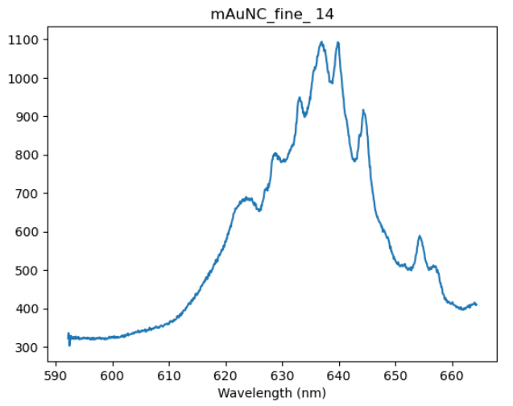

Slide 36
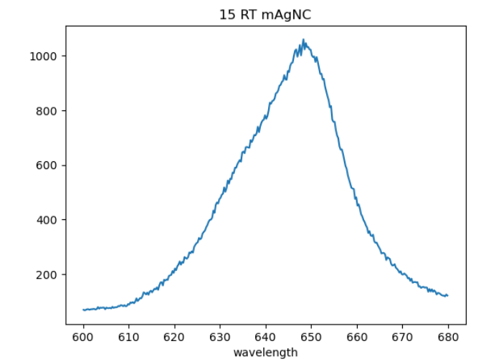
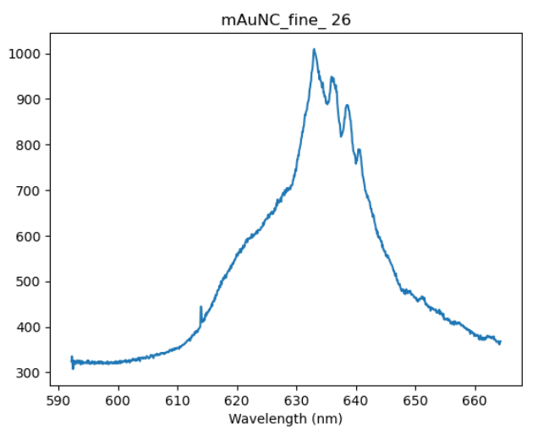

Slide 37
The following comparisons are interesting because the PL spectrum from the points resemble each other, but the correlated points from prior measurements have even more drastically different spectra. They also resemble uncorrelated points…

Slide 38
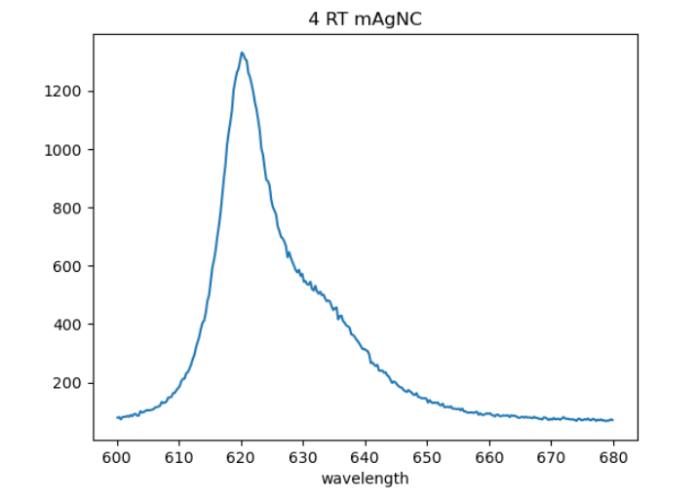
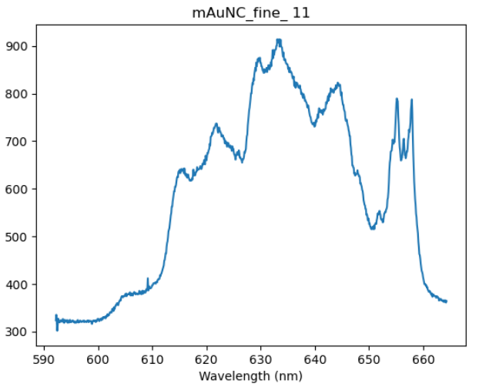
Notes:
There are still peaks in the same wavelength but at different intensities

Slide 39
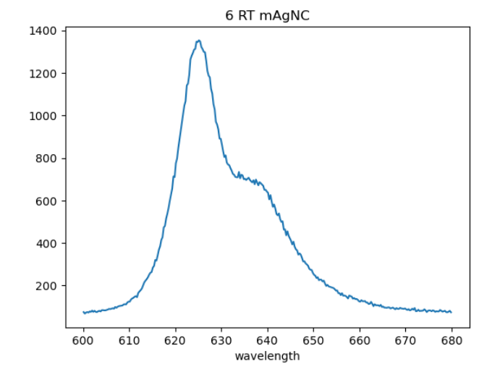
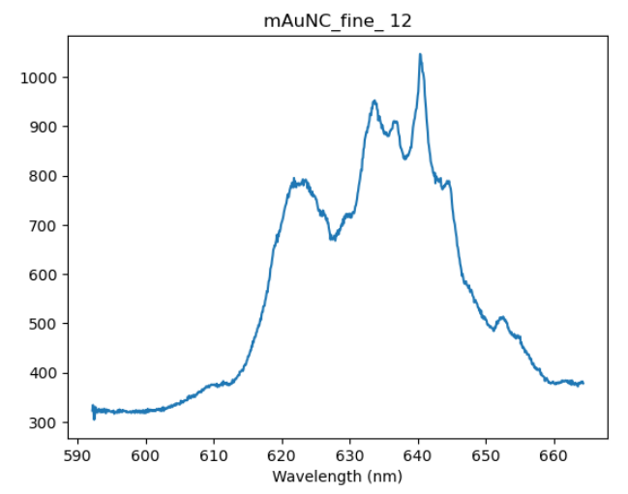
Notes:
Would not be surprised if these points just happened to appear to be the same as certain gold nanocube points when they are in reality actually silver

Slide 40
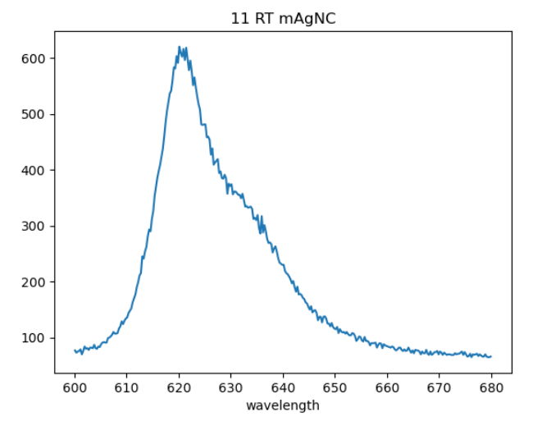
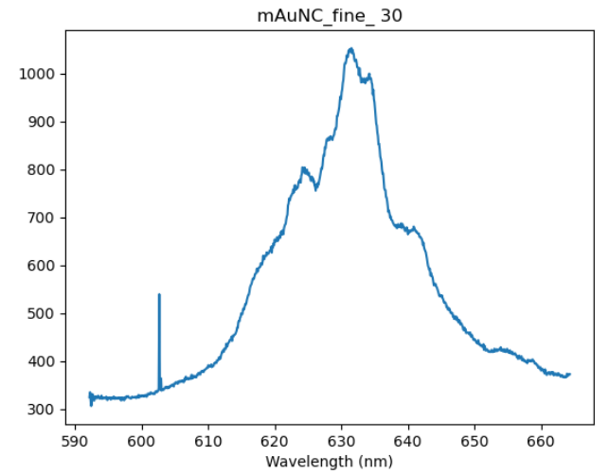

Slide 41
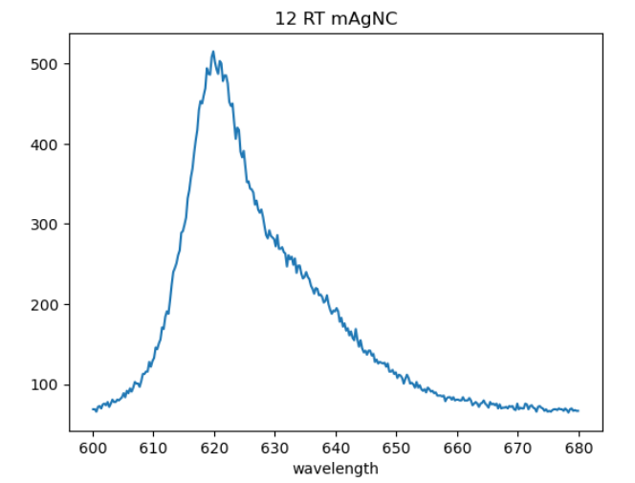
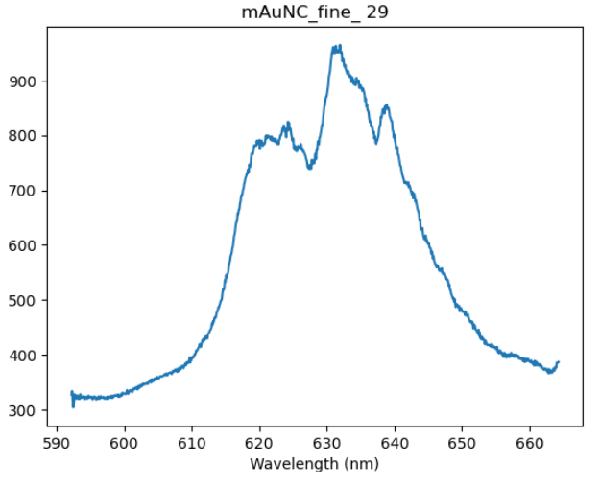
Notes:
The 620 nm point is where all these cleaner spectra peak

Slide 42
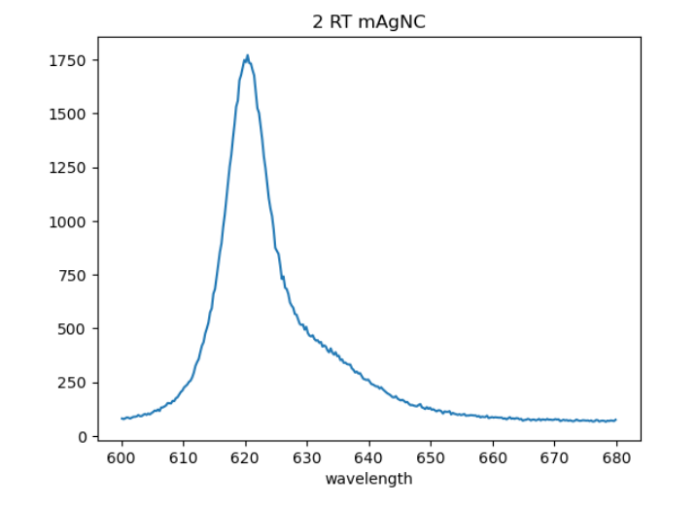
Point 2 is most likely a silver nanocube – out of all the new point measurements, it was the most isolated from old points.
Notice the peak at around 620 nm corresponding to a very high intensity

Slide 43
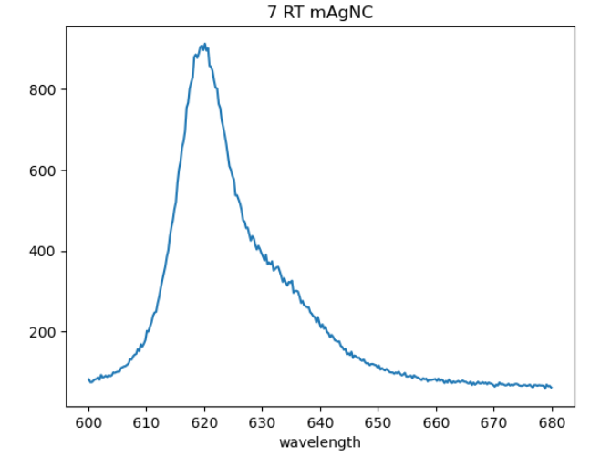

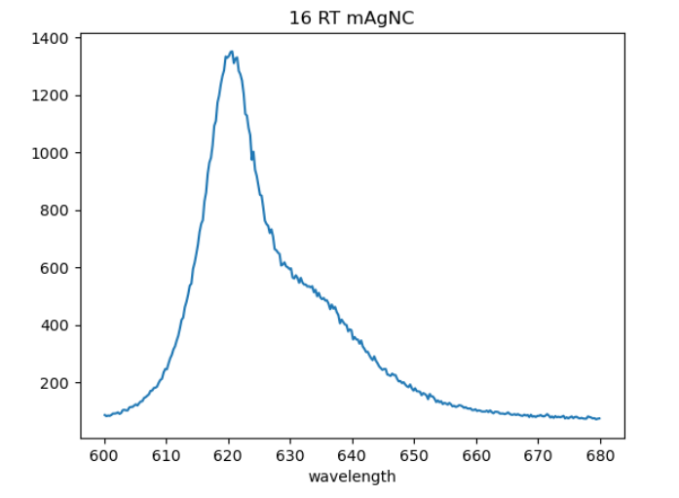
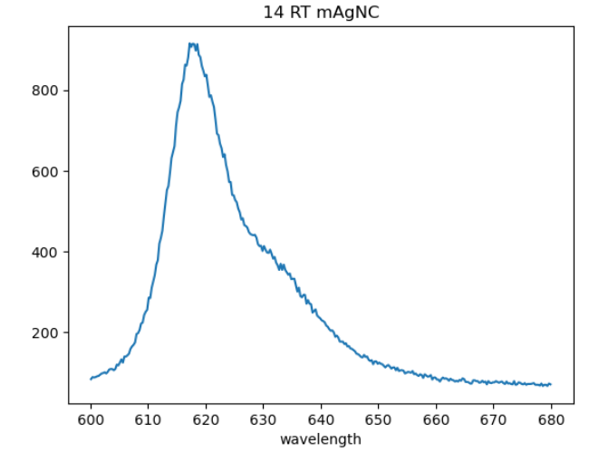
Notice how these spectra have a similar structure. Point 16 is notably outside of the general range of intensity for the peak. It is possible that these denote silver nanocubes.
Notes:
The thing that differentiates these silver candidates from the points of similar spectra before is that these did not seem to be close enough to the gold nanocube points to warrant any assumption that they could be the same points

Slide 44
Do the spectra of the same points peak at the same wavelengths between the samples? How does the presence of silver nanocubes impact the measurements?
It seems like some peaks existed in both measurements between the same gold nanocube points, but the spectra of gold cubes from the sample with silver nanocubes had significantly more peaks at higher intensities. There may be some odd interactions between the gold and silver cubes.
Can we identify which points are likely silver nanocubes?
Point 2 is definitely silver, points 7, 13, 14, and 16 are also likely silver. Especially 7.
Notes:
Recall from before the darkfield spectra measuring the plasmonic resonances of the gold nanocubes? There was a point to note — the peaks around the 620-625 nm mark. In the gold nanocube sample neglecting the presence of silver cubes, the intensity did peak in that range. So did the intensity including silver cubes and that of the silver cubes. This correlation would be more clear if we had darkfield spectra data from the silver cube sample.

Slide 45
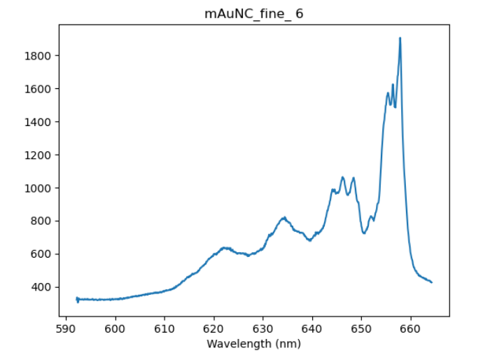
In general, how do the peaks differ between the gold and silver nanocubes? Does either provide more obvious enhancement?
The gold nanocubes without any influence from the silver caused the highest peaks in the spectrum to be in the 1000-1200 intensity range and the 615-620 nm range.
Overall, it appears the silver candidates have cleaner spectra and more obvious peaks than the gold nanocubes did. With the current data, there’s no discernable difference in whether or not there’s more obvious enhancement between the silver and gold nanocubes.
Gold outlier
Silver outlier

Slide 46
Semester Progress
Optical data analysis + summary for nanocube project (Sample 1)
Noise reduction code using DMD algorithm
Lots of graphene exfoliation + practice transfers with graphene and HBn during slower weeks

Slide 47


Grey points - Cryo Au
Blue points - Cryo Ag
Ag — Au
8 - new silver
10 - 27
17 - 21
21 - 9
22 - 6
23 - new silver
26 - 17
29 - 33
35 - 28
36 - 29
42 - new silver
43 - 3
9 - 40
13 - 25
20 - 11
25 - 12
27 - new silver
31 - new silver
33 - 5

Slide 48

Cryogenic mAgNC cleaned

Slide 49






Slide 50



Slide 51



Slide 52



Slide 53



Slide 54



Slide 55



Slide 56



Slide 57



Slide 58



Slide 59



Slide 60



Slide 61



Slide 62



Slide 63



